Slide 1
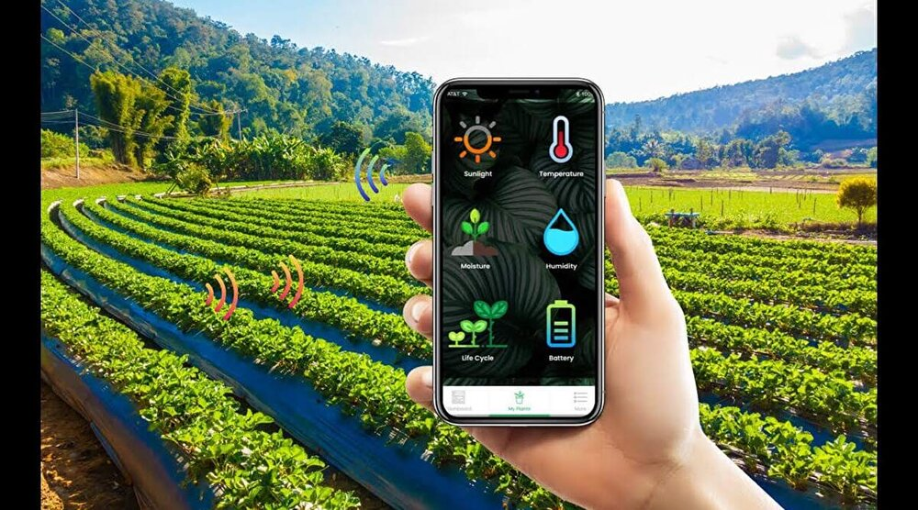
Smart Irrigation System

Slide 2
Points To Be Cover…
Introduction
Objective
Hardware Required
Circuit Design
Programming Logic
Advantages
Conclusion

Slide 3
Introduction
India's population crossing 1.3 billion in 2016
So balance between the optimum population growth and a healthy of nation is far to be achieved.
The rising population need for increased agricultural production Irrigated agriculture has been important source increased agricultural production
"IOT based smart irrigation system" is for to create an IOT base automated irrigation mechanism which turns the pumping motor ON and OFF pass command through IOT platform.

Slide 4
Objective
Save water and reduce human intervention in the agriculture field
Continuously Monitoring the status of sensors and provide signal for taking necessary action
To get the output of soil water sensor and provide water to crop
To observe other parameters for better yield

Slide 5
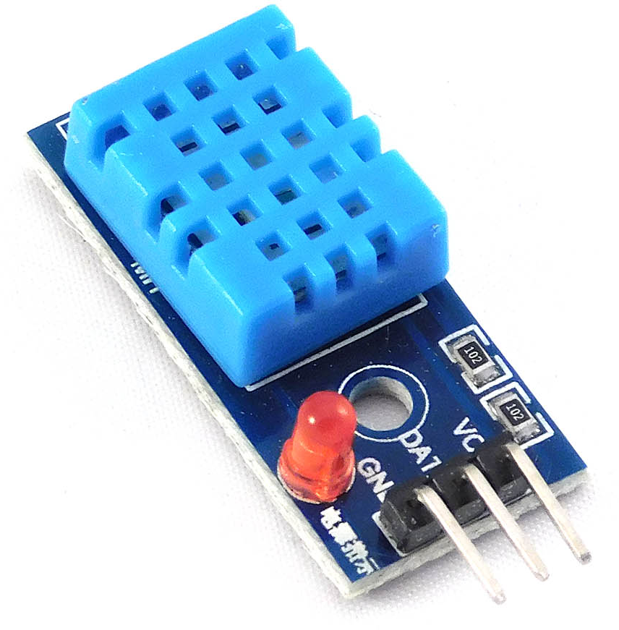
Hardware Required
DHT11 Sensor
The DHT11 sensor is a basic, low-cost digital temperature and humidity sensor. It is commonly used in projects where monitoring environmental conditions is necessary. The sensor consists of a capacitive humidity sensor and a thermistor to measure temperature. It provides digital output for both temperature and humidity readings, making it easy to interface with microcontrollers or single-board computers like ESP8266.

Slide 6
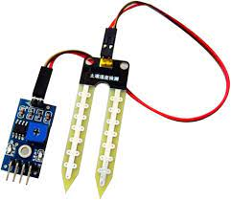
Hardware Required
2. Moisture Sensor
The moisture sensor, also known as a soil moisture sensor, is a device used to measure the moisture content in soil. It typically consists of two probes that are inserted into the soil, and the resistance between these probes changes based on the moisture level in the soil. When the soil is dry, the resistance is higher, and when it's moist, the resistance decreases.
Moisture sensors are commonly used in gardening and agriculture to monitor soil moisture levels and automate irrigation systems accordingly.

Slide 7
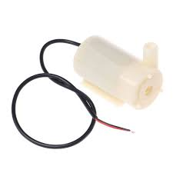
Hardware Required
3. Pump
Water pumps in a smart irrigation system are integral components responsible for pumping water from its source, such as a well, reservoir, or water storage tank, to the irrigation system. These pumps are often equipped with sensors and controllers that allow for automated and optimized water delivery based on factors such as soil moisture levels, weather conditions, plant water requirements, and even time of day.

Slide 8
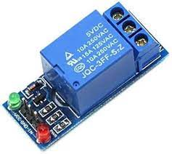
Hardware Required
4. Relay
In an irrigation system, relays are used to control the operation of various components such as water pumps, valves, and sensors. For instance, a relay may be employed to activate a water pump when the soil moisture sensor detects dry conditions, ensuring plants receive adequate water. Similarly, relays can open or close valves to regulate water flow in different zones of the irrigation network based on scheduling or sensor inputs. Overall, relays play a crucial role in automating and optimizing the irrigation process, improving water efficiency and crop health.

Slide 9
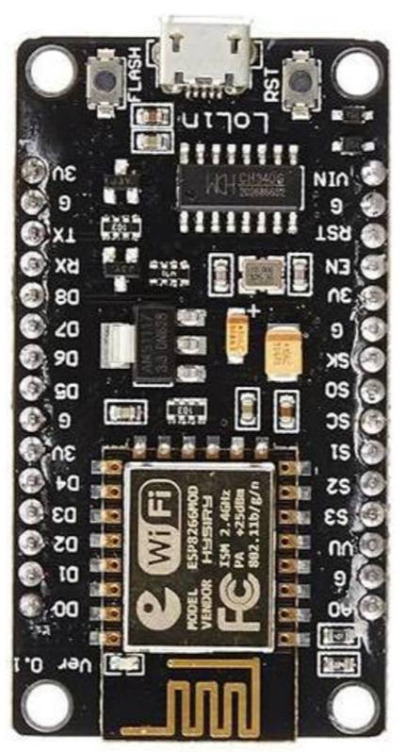
Hardware Required
5. NodeMCU
The NodeMCU ESP8266 is a powerful and compact development board designed for IoT applications. It integrates an ESP8266 WiFi module, which enables seamless wireless connectivity, allowing devices to communicate over local networks or the internet. With its onboard microcontroller unit (MCU), GPIO pins, and support for Arduino IDE and Lua scripting, the NodeMCU offers versatility and ease of programming.

Slide 10
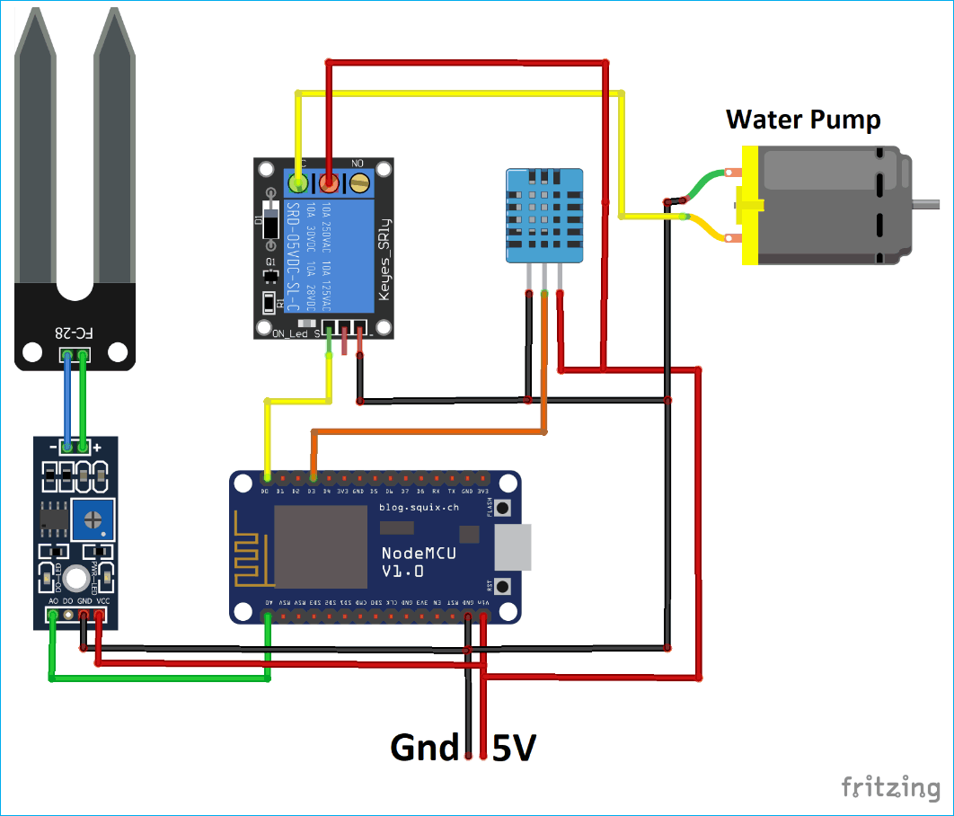
Circuit Design

Slide 11
Explanation
The smart irrigation system utilizes an ESP8266 microcontroller (such as NodeMCU) as the brain of the operation. It connects wirelessly to your local Wi-Fi network, enabling communication with other devices and services.
Sensors include the DHT11 for monitoring temperature and humidity levels, providing valuable environmental data for optimizing watering schedules. Additionally, a moisture sensor measures soil moisture content, ensuring plants receive the right amount of water.
Relays are employed to control the water pump, activating it based on sensor readings and predetermined thresholds. This allows for efficient water distribution to the irrigation system.
The system's data and status can be displayed and monitored in real-time via the Blynk app, a user-friendly IoT platform. Through the app, users can visualize sensor data, adjust watering schedules, and receive notifications about irrigation activities.

Slide 12
Programming Logic
1. Initialization:
Set up the ESP8266 Wi-Fi connection.
Initialize the Blynk app and establish a connection. Configure pin modes for sensor inputs, relay control, and any other necessary peripherals.
2. Data Acquisition:
Read data from the DHT11 sensor to obtain temperature and humidity values. Read data from the moisture sensor to determine soil moisture levels.
3. Decision Making:
Based on the sensor readings, determine if watering is needed. Compare the current soil moisture level with predefined thresholds to decide whether to activate the pump. Use conditional statements to control the relay that powers the water pump.

Slide 13
4. Action:
If watering is required, activate the relay to turn on the water pump.
Ensure the pump remains active for an appropriate duration to sufficiently water the plants. If no watering is needed, deactivate the pump.
5. Feedback and Monitoring:
Update the Blynk app with real-time sensor data, including temperature, humidity, and soil moisture levels. Send notifications or alerts through the Blynk app to inform the user about watering activities or any anomalies detected by the sensors.
6. Loop:
Continuously repeat the above steps in the main loop to provide continuous monitoring and control of the irrigation system.

Slide 14
Explanation
By continuously monitoring soil moisture levels and environmental conditions, the system ensures that plants receive the right amount of water at the right time, minimizing water wastage and promoting efficient water usage.
With real-time data on temperature, humidity, and soil moisture, the system can adjust watering schedules to meet the specific needs of different plants, resulting in healthier growth and improved crop yields.
The system automates the irrigation process, reducing the need for manual intervention. Users can remotely monitor and control the system through the Blynk app, providing convenience and flexibility in managing irrigation tasks.
By optimizing water usage and reducing unnecessary watering, the system contributes to water conservation efforts, helping to preserve natural resources and mitigate environmental impact.

